Slide 1
Advanced VPC Theory
-- Manu

Slide 2
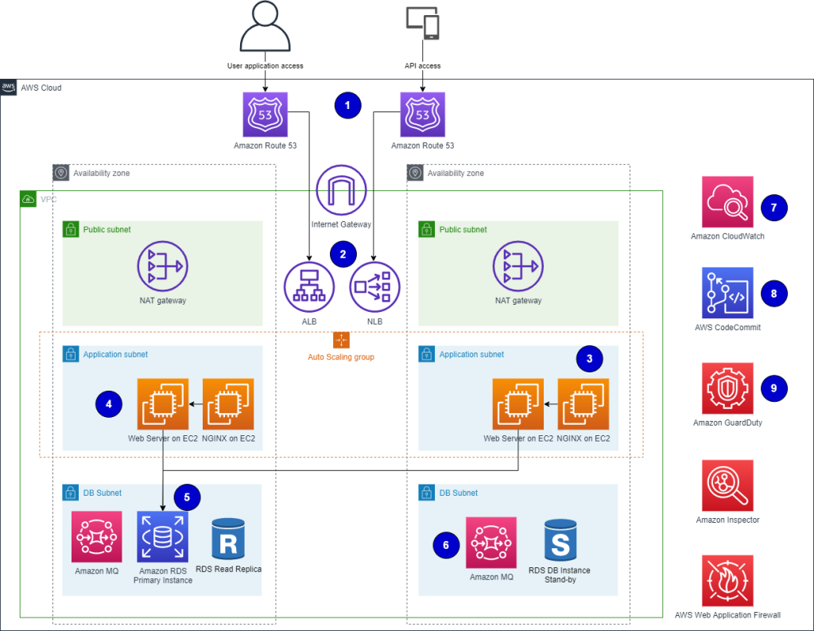
VPC

Slide 3
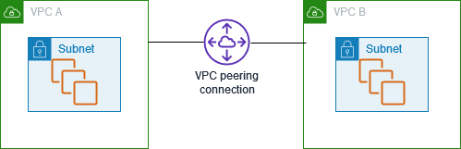
VPC Peering Connection
Notes:
https://docs.aws.amazon.com/vpc/latest/peering/what-is-vpc-peering.html

Slide 4
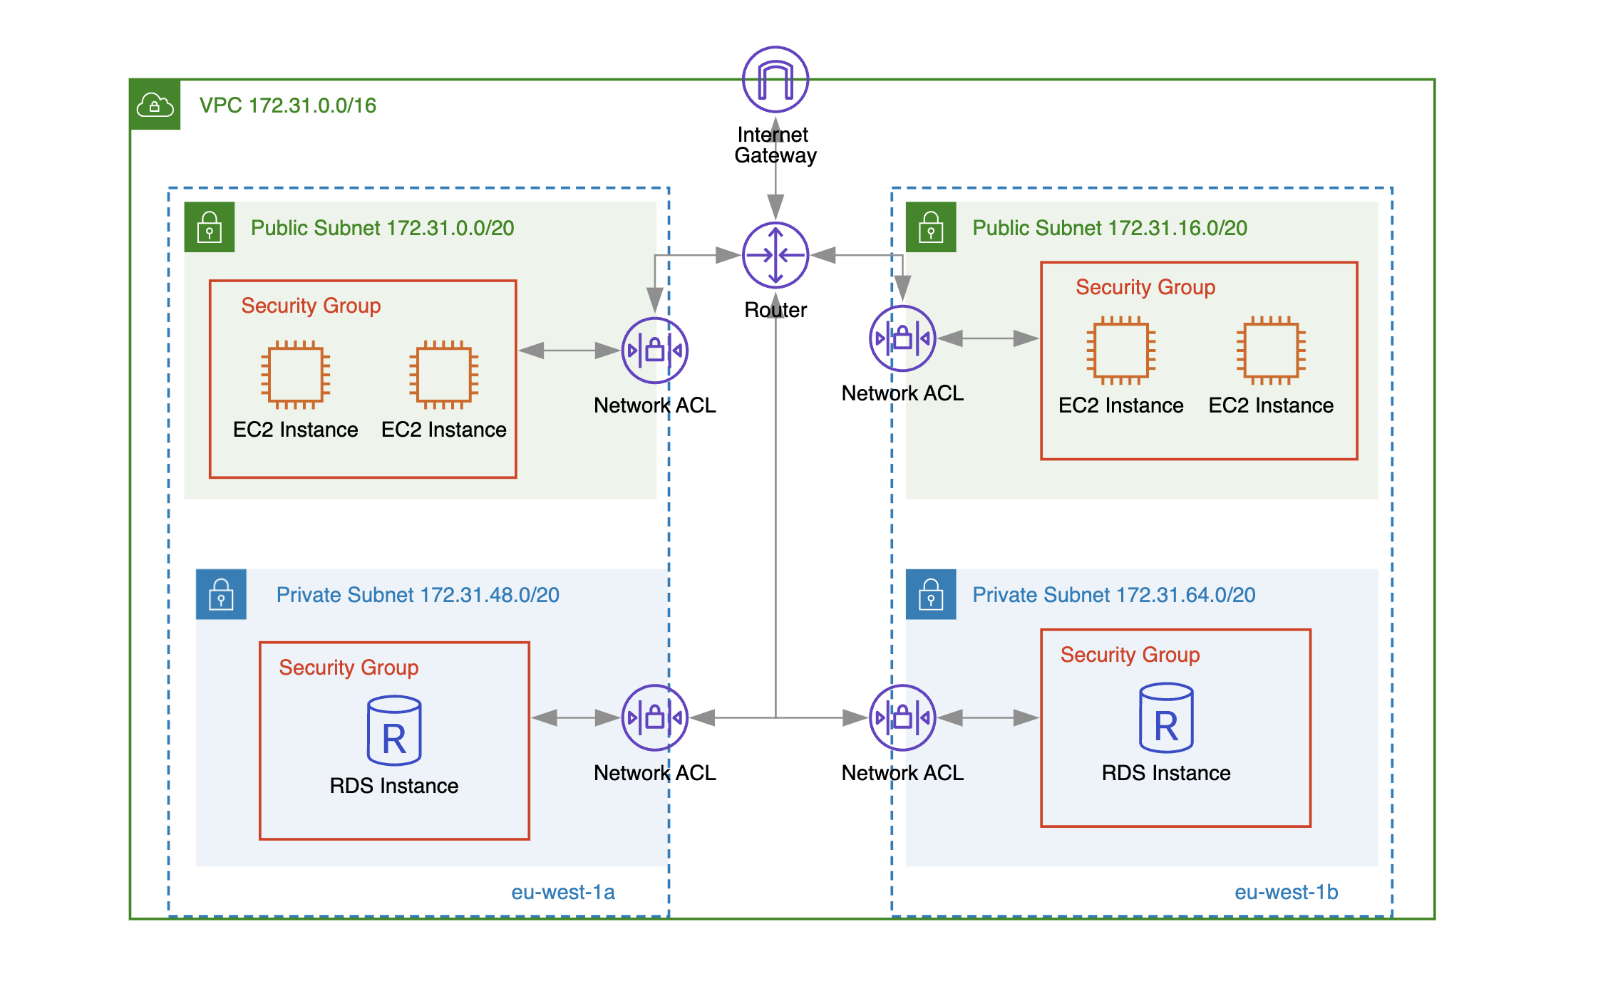
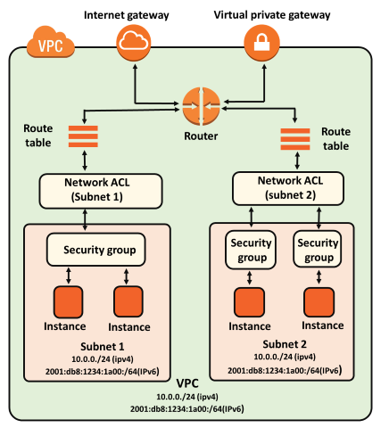
VPC Network ACLs

Slide 5
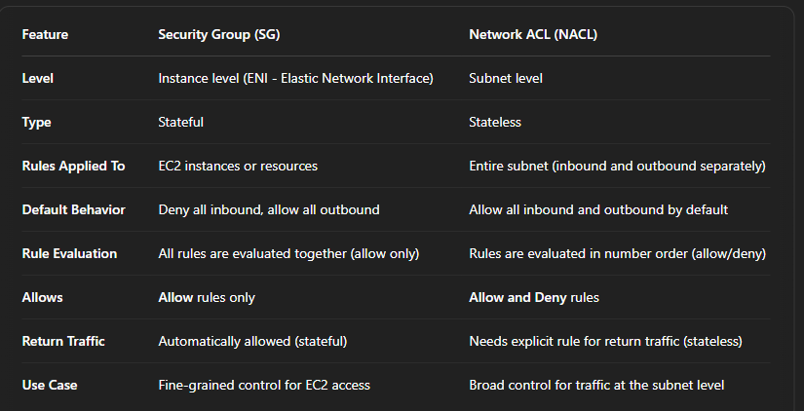
Network ACLs vs Security Group

Slide 6
Stateless vs Stateful Firewalls

Slide 7
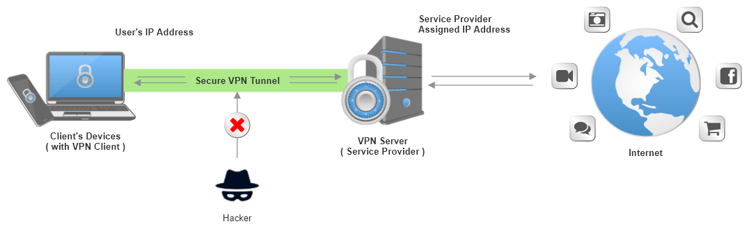
AWS VPN
How VPN Works

Slide 8
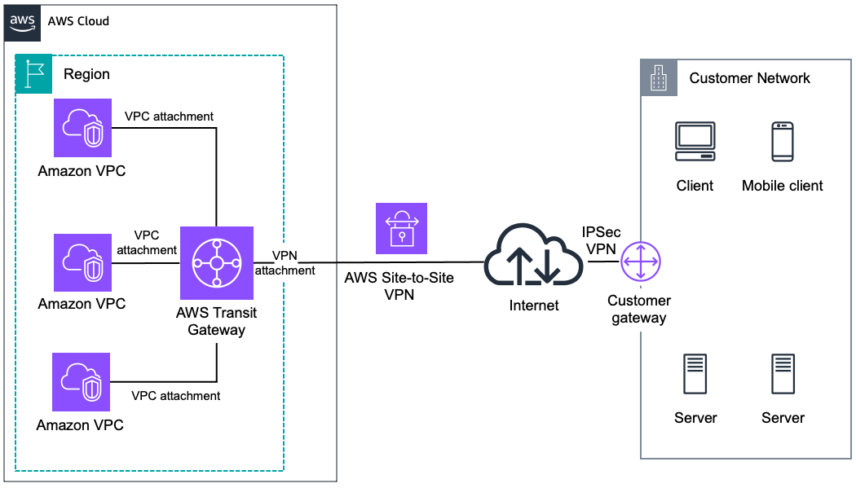
AWS VPN and Transit Gateway
Notes:
AWS VPN lets you securely connect your on-premises network or client device to your AWS VPC over the internet using an IPSec tunnel.
🔧 Types:
Site-to-Site VPN: Connects your on-premises data center to a VPC.
Client VPN: Connects individual users (like employees working remotely) to AWS.
🧱 Key Components:
VPN Gateway (VGW) – AWS side.
Customer Gateway (CGW) – Your on-prem device or software.
✅ Use Case:
Quick and secure connectivity between your data center and AWS.
Backup connection to Direct Connect.
Remote workforce accessing AWS resources.
🔁 2. AWS Transit Gateway (TGW)
What it is: A hub-and-spoke model that allows centralized connectivity between multiple VPCs, on-prem networks, and VPNs through a single gateway.
📌 Why it’s powerful:
Avoids complex VPC peering mesh (which becomes unmanageable at scale).
Acts as a central router for all traffic.
⚙️ Key Features:
Scales to thousands of VPCs.
Connects to Direct Connect, VPNs, and even other TGWs.
Supports route propagation and attachments.
✅ Use Case:
Large-scale, multi-VPC architectures.
Centralized network management.
Hybrid cloud with multiple data centers + VPCs.
🔄 How AWS VPN & TGW Work Together
You can attach a VPN connection to a Transit Gateway, allowing all VPCs connected to the TGW to access your on-prem network through the VPN.

Slide 9
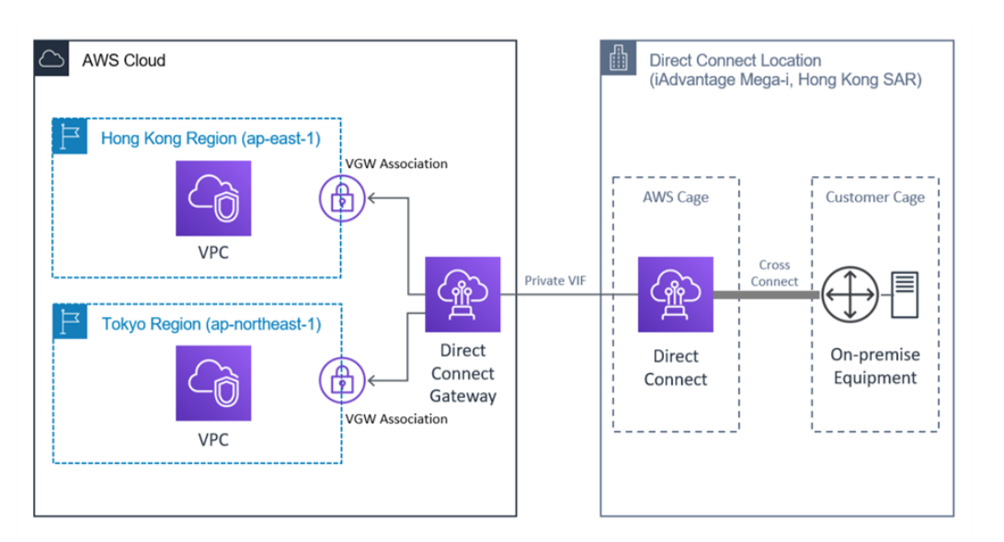
AWS Direct Connect

Slide 10
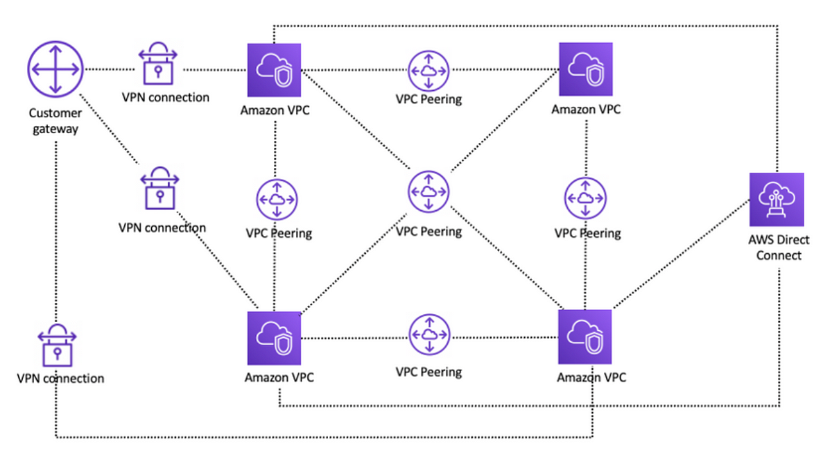
AWS Network architecture without transit gateway

Slide 11
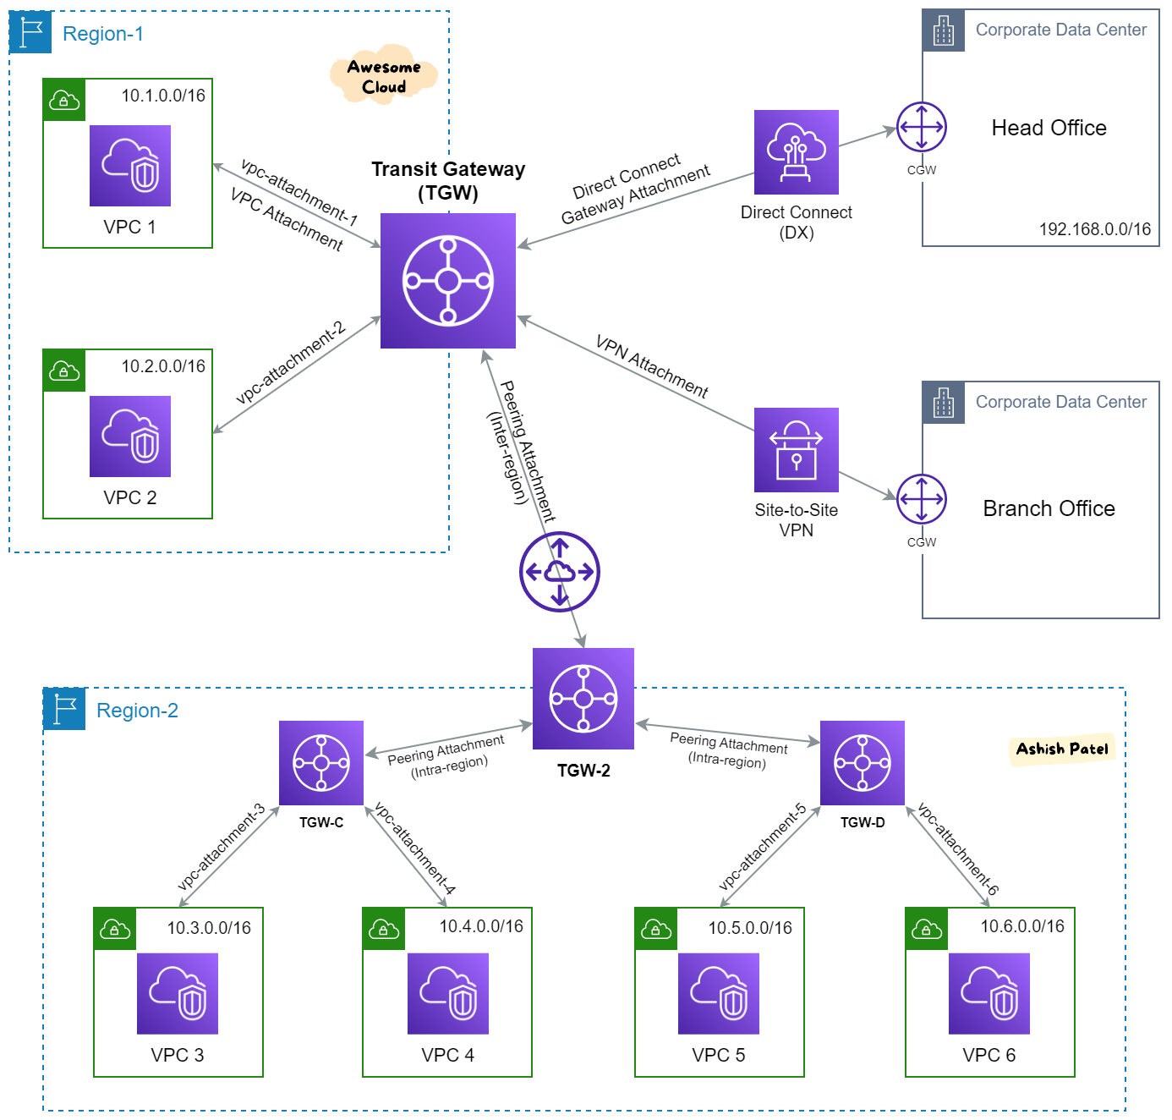

Slide 12
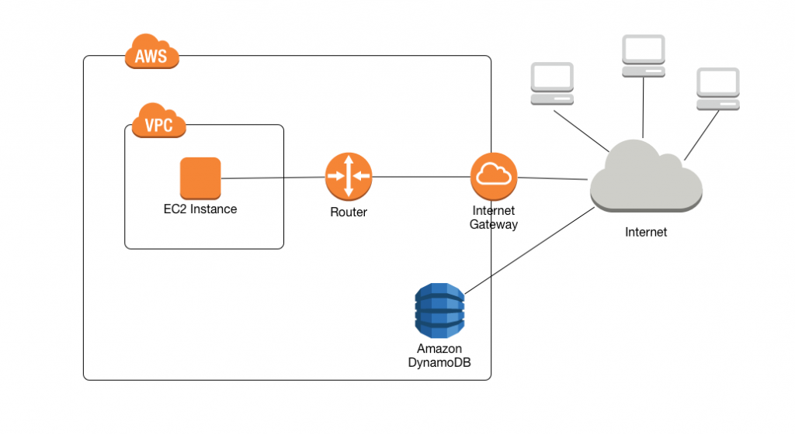
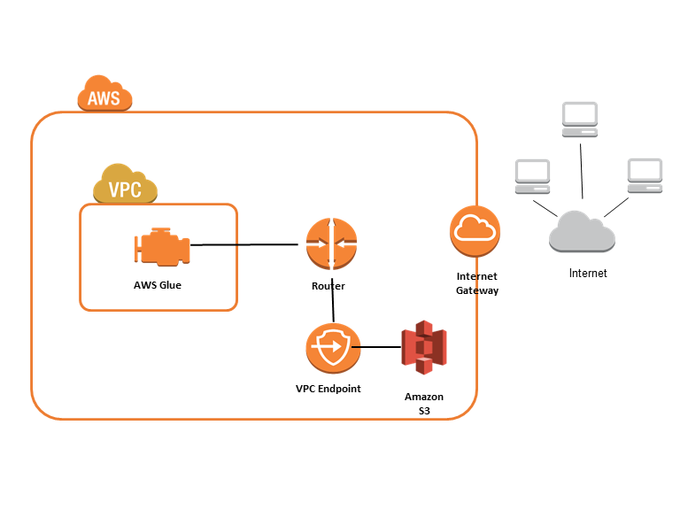
AWS VPC Endpoint
Before VPC Endpoint
After VPC Endpoint

Slide 13
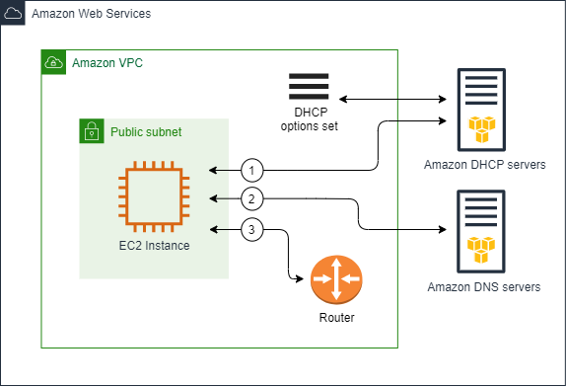
AWS DHCP Option Sets
Notes:
https://docs.aws.amazon.com/vpc/latest/userguide/DHCPOptionSetConcepts.html

